Slide 1
Introductions
OA2020 is a global alliance committed to accelerating the transition of scholarly communication to open access by converting subscription investments into funds to support open access publishing. An integral part of our mission is ensuring that scholars everywhere are able to publish their articles openly under conditions that are fair, sustainable and globally equitable.
ESAC is an open community of information professionals dedicated to putting the vision of open access to research into practice.
Library-led standards and good practice to optimize fully OA and transformative agreements
Optimizing open access publishing workflows for authors and libraries
Promoting standards and good practice related to data exchange and analysis
Increasing transparency around the market conditions in scholarly publishing
Sharing experience and insights to make our publisher negotiations more impactful
Building capacity in libraries and consortia to prepare for a fully open access paradigm
Read more ESAC Initiative esac-initiative.org;
Equity is integral to the OA2020 mission oa2020.org/be-informed/equity/
US OA2020 WG Community of Practice call | 24 Feb 2022

Slide 2
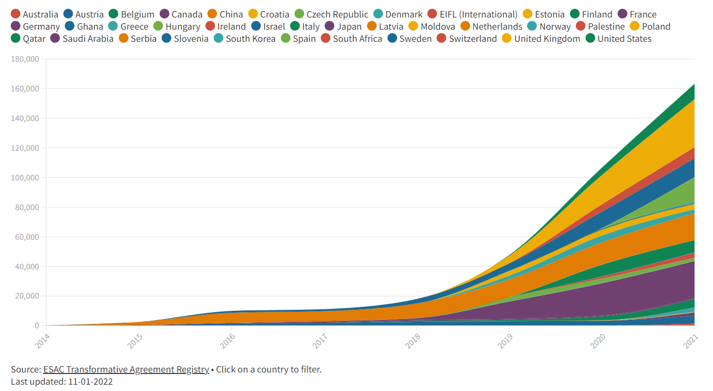
ESAC Market Watch and TA Registry
Source ESAC Market Watch esac-initiative.org/market-watch/
Based on ESAC Registry of Transformative Agreements esac-initiative.org/about/transformative-agreements/agreement-registry/ [Last updated: 11 Jan 2022]
US OA2020 WG Community of Practice call | 24 Feb 2022

Slide 3
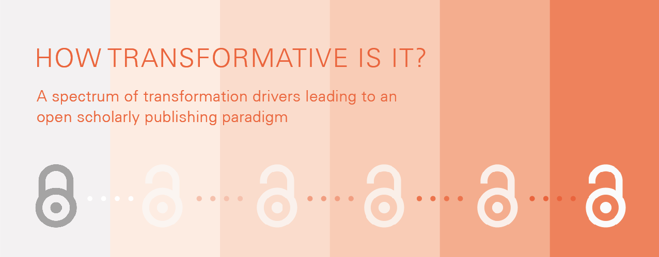
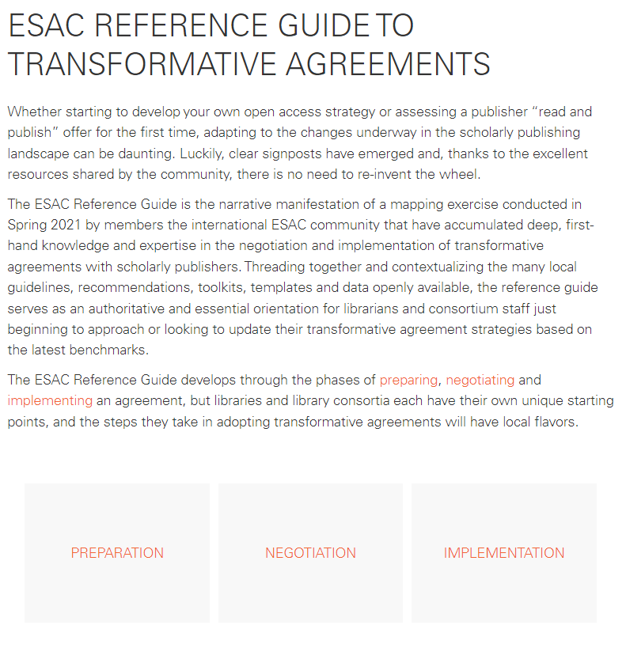
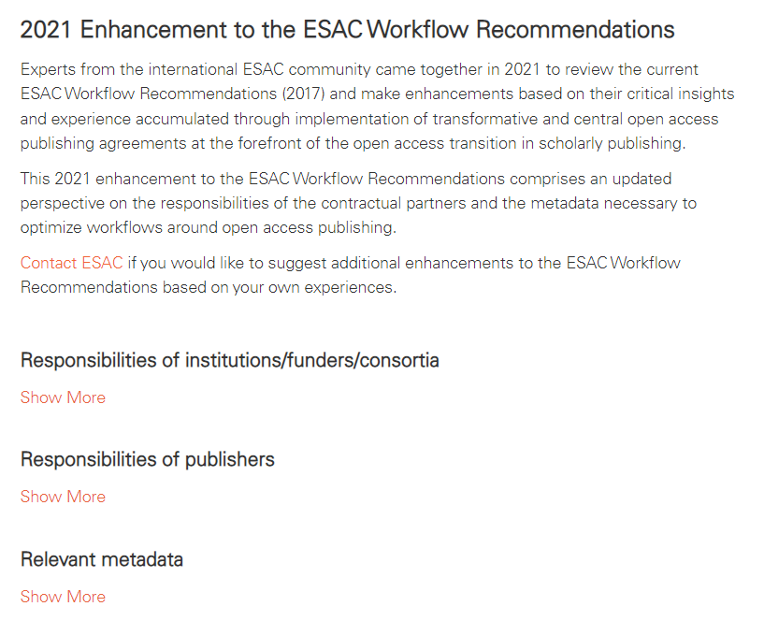
New ESAC resources
Source esac-initiative.org/new-esac-resources-on-transformative-agreements/
US OA2020 WG Community of Practice call | 24 Feb 2022

Slide 4
Putting Open Access into practice
ESAC global community of practice calls are opportunities for library and consortium staff—as well as publishers and other stakeholders—to exchange experiences in operationalizing open access through transformative and other OA publishing frameworks.
How are transformative agreements actually transforming the subscription system and enabling an open paradigm?
Open access transformation drivers
Submission system and author engagement
Publishing workflow and library processing workflow
Business models and instituitonal investment streams
Price transparency and cost assessment
Open metadata and data delivery and OA monitoring
How are transformative agreements actually transforming the subscription system and enabling an open paradigm?
Open access transformation drivers
Submission system and author engagement
Publishing workflow and library processing workflow
Business models and instituitonal investment streams
Price transparency and cost assessment
Open metadata and data delivery and OA monitoring
Join us on
23 March
9:00am Pacific
12:00pm Eastern
Featuring
The Royal Society
FinELib consortium
Stay tuned @ESACInitiative and esac-initiative.org/category/news/
US OA2020 WG Community of Practice call | 24 Feb 2022

