Slide 1

UC’s OA principles, policies, & practices
foundations for action to advance open access
OA2020 / COAPI
May 27, 2021
Ellen Finnie
California Digital Library
Notes:
Image from https://images.app.goo.gl/dtrUNET8dxrShbnY9
many-colorful-hands-surrounding-earth-globe

Slide 2
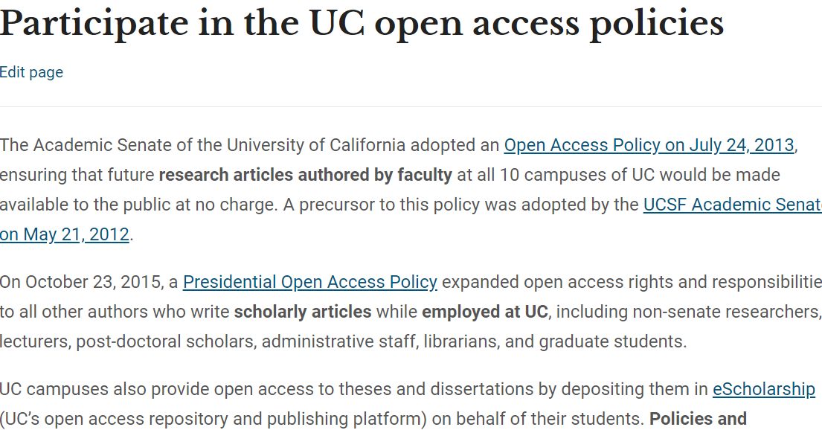
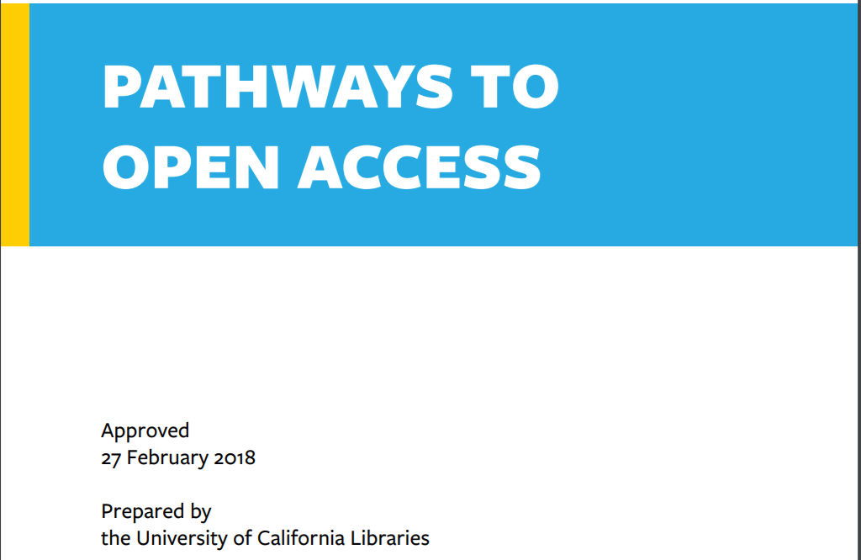
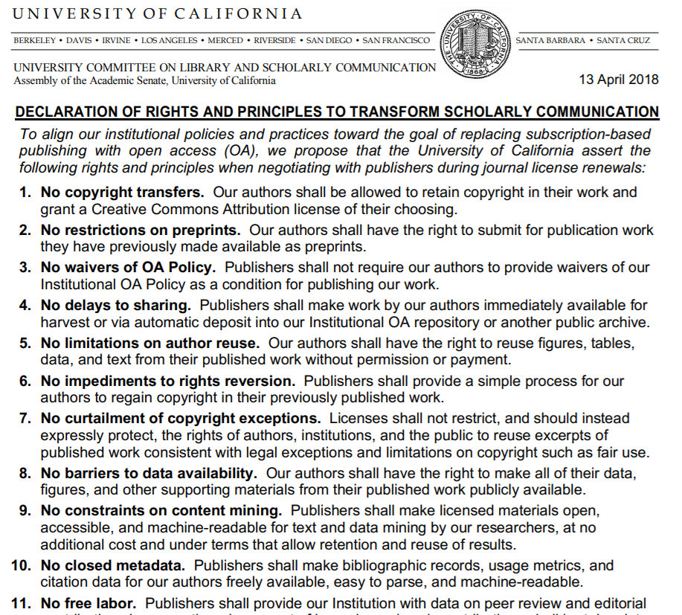
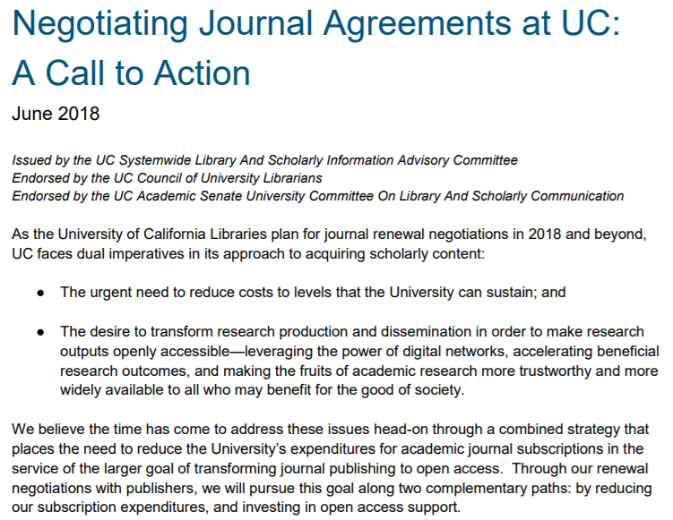

Multiple pathways to OA
Collaborative action: Faculty, Administration, Library
Open Access policies (2012+)
Libraries roadmap (Pathways to OA) - Feb 2018
Senate (Library committee) Declaration - April 2018
UC Provost advisory Call to Action - June 2018
Libraries announce negotiations project –
June 2018
Notes:
Given that focus on UC’s OA policies and principles, I thought it would be helpful background to provide a brief summary of them.
All authors across UC are covered by open access policies. The faculty open access policy is permission-based policy, like the Harvard policy, which resets the copyright default for UC authors, through providing a license to UC that allows for depositing articles to our repository, eScholarship.
Faculty principles for advancing open access publishing form another important strategic foundation for UC’s transformative agreements. These principles were issued in 2018 by the system-wide Academic Senate committee that advises the University President on scholarly communication matters --They issued a statement of principles meant to support replacing subscription-based publishing with open access (OA).
Shortly after these Principles were issued,the Systemwide Library and Scholarly Information Advisory Committee, which has representation from faculty, libraries, senior administrators, and more) issued a comprehensive open access strategy, entitled “A Call to Action,” which articulates our aim at UC to control costs while advancing models that provide Open Access to UC’s research. This call to action was endorsed by both by the senate committee and the Council of University Librarians, and announced along with strategies for journal negotiations.
One outcome was the formation of a team of librarians and faculty to focus on negotiating a shift from subscription agreements to open access agreements, which is the team that oversaw and carried out the Elsevier negotiations.
And finally, the libraries roadmap “pathways to OA” affirmed in 2018 that UC would follow multiple strategies to advance OA and to shift funds away from subscriptions and towards open access. The libraries released the Pathways to Open Access toolkit ,analyzing a wide range of strategies in order to help each individual UC campus – and potentially others outside UC -- evaluate which option(s) best serve their goals as they work to shift funds away from subscriptions.
BACKGROUND ON UC POLICY TIMING:
The initial policy at the Univ of CA San Francisco was expanded to the entire UC faculty in 2013 and then through a presidential policy in 2015, to all authors employed at UC, including non-senate researchers, lecturers, post-doctoral scholars, administrative staff, librarians, and graduate students.

Slide 3
Coordinated, multi-pronged approach
Publisher agreements – variety of OA models
Open Access policies
Library publishing
Open infrastructure
Notes:
This commitment to multiple pathways to advance open access is a coordinated multi-pronged approach to supporting open access – it is the foundation of our work at UC.
Our efforts include publisher agreements, including a range of business models, both APC based and not APC based; leveraging our open access policies, which in in the past year yielded 30K deposits [of which 16,000 were author-based deposits); our extensive library-based publishing, and building and investing in open infrastructure.
These efforts are focused on what we, in libraries, can actively do now, with our investments and within our scope, to advance open access responsibly and iteratively, in support of a worldwide transition to open access.

Slide 4

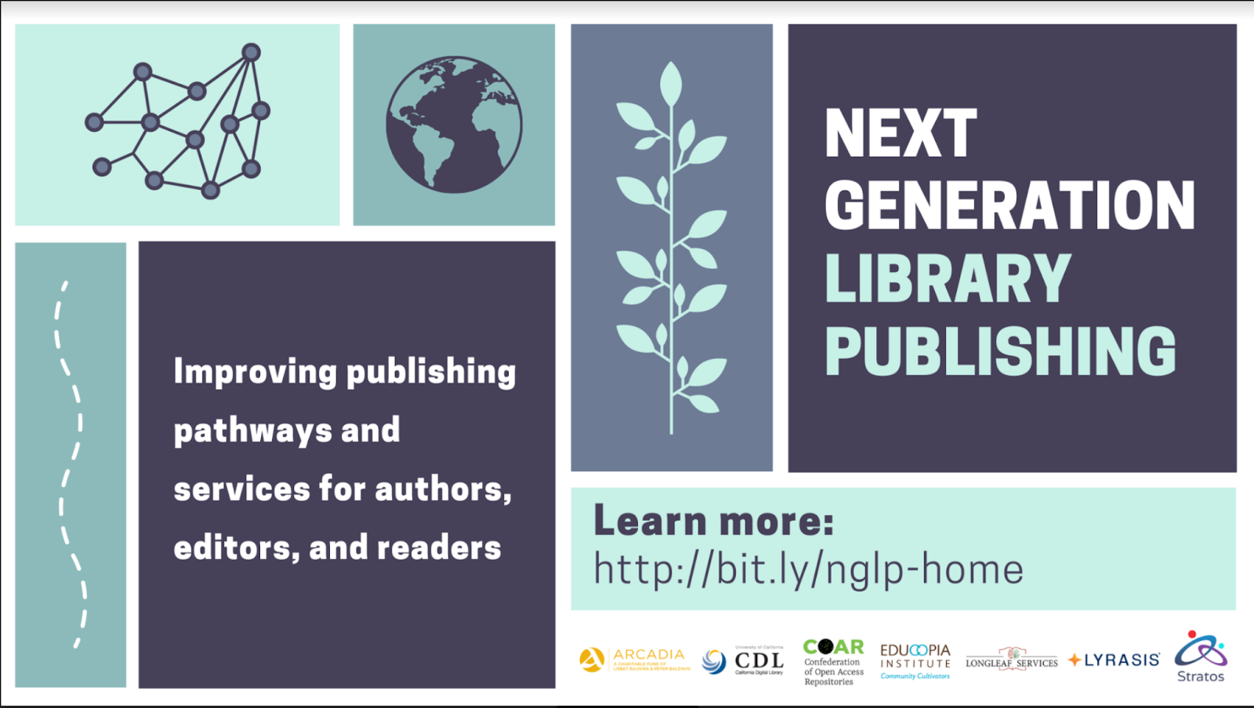



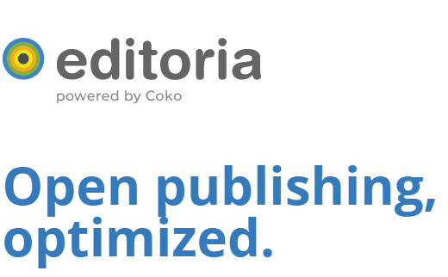
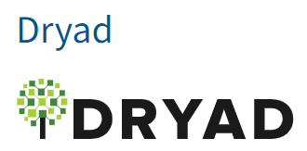
CDL-based OA infrastructure (selected list)
Notes:
One of the paths to OA that UC supports heavily is the open infrastructure needed to support a robust, open ecosystem. At the California Digital Library, we have created, or worked with others to create, open source tools that advance open access. These include data sharing services such as Dryad, essential metadata infrastructure such as the Research Organization Registry, and platforms for open access publishing for monographs, journals, and preprints, including NexGen library publishing, a new program to build a unified institutional repository and journal publishing solution focused specifically on creating an open source alternative to bepress’s Digital Commons platform.
.

Slide 5











eScholarship: OA publishing alternative to commercial publishers
Notes:
the eScholarship library-based publishing program represents a particularly broad and deep commitment to and investment in open access at UC. The program is
Committed to open access,
Tuned to the needs of the faculty and students, rather than the marketplace, and is
Dedicated to providing publishing opportunities for new disciplines and new voices.
It is Experimental– we are keen to try new models and reimagine scholarly publishing.
And It is Designed to provide low cost/equitable access to both research and publishing
Very importantly, it is scholar-led, and aligned with the academic values of UC
The eScholarship journal publishing program includes 85 journals.
Of particular note given today’s topic are two titles that involved a transition from Elsevier, Combinatorial Theory, and Glossa Psycholinguistics, whose parent title Glossa transitioned from Elsevier. Publishing these titles is a good illustration of our approach – we see these titles as a strong manifestation of our commitment to creating and supporting alternatives even as we seek to transform the status quo.
More background:
Combinatorial Theory
You may recognize Combinatorial Theory --This journal formed after the editorial board resigned en masse from Elsevier’s Jnl of Combinatorial Theory - Series A. The journal will go live later this year.
Glossa Psycholinguistics
You may also recognize Glossa , and in this case Glossa Psycholinguistics – a new spinoff journal from Glossa, which was formed in 2016 after the editorial board of Lingua resigned from Elsevier. Glossa’s founding editor approached eScholarship to host this new journal. The journal is committed to maintaining low APCs, so has secured institutional funding to close its funding gap. It will launch in the next month or so.
Other possible examples:
Transmodernity
This Journal of Luso-Hispanic and U.S. Latino literary and cultural studies… promotes the study of marginalized areas of Luso-Hispanic cultural production of any period and invites submissions of unpublished studies dealing with peripheral cultural production in the Luso-Hispanic world.’ Representative of the many eScholarship journals that operate without any additional resources. Transmodernity was recently accepted into SCOPUS.
UCLA School of Law - in the past few years, 12 UCLA law reviews have migrated to publishing with eScholarship

Slide 6
CDL collections investments in OA (selected list)
  arXiv
  DOAJ
  DOAB
  Knowledge Unlatched
  OA Switchboard
  Open Library of Humanities
  Open Citations project
  SCOAP3
  Transformative agreements
Notes:
In addition to building open access infrastructure at UC, and the significant library publishing program we host, we use our collections budget to invest in other open access infrastructure as well. I’m sure you will find this list familiar– these projects are absolutely core to building an open scholarly ecosystem for the full lifecycle of research.
The investment area that has received a lot of attention recently is our transformative agreements, the final bullet here, and that is what we will explore next. But this kind of investment is just one kind among many OA paths at UC.
Background info:
Note that Open Citations project and DOAB are The Global Sustainability Coalition for Open Science Services (SCOSS) projects.

Slide 7
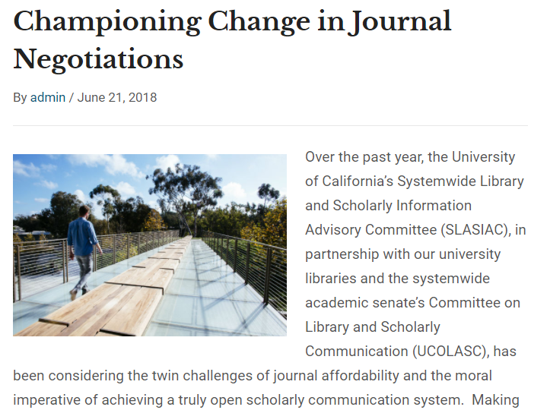
Collaboration to convert subscriptions to OA
Team formed by UC Libraries + Faculty Senate summer 2018
To advance one tactic in shared strategic plan to accelerate the transition to open access:
Converting subscription licenses to
open access publishing agreements
18 member library / faculty working
group
Negotiating team
  3 librarians
  3 faculty
https://osc.universityofcalifornia.edu/2018/06/championing-change-in-journal-negotiations/
Notes:
The organizational structure that provides the foundation for negotiating our transformative agreements was established in the summer of 2018, with the formation of a team I mentioned earlier, that includes both UC libraries and members of the faculty senate. The aim of the group is to advance ONE of our tactics to accelerate the transition to open access – converting subscription licenses to open access agreements.
The group is an 18 member team including librarians and faculty, with a subgroup of 6 – including 3 librarians and 3 faculty -- carrying out the negotiations with publishers.

Slide 8
Contributions of transformative agreements
Providing support for UC authors’ current publishing practices
Integrating institution-wide APC spend to control costs
Advancing open access for the majority of UC articles
Notes:
We have invested in creating this team, because we see significant contributions from transformative agreements, as one path on the overall shift to OA.
These agreements:
Provide support for UC authors’ current publishing practices
Integrate institution-wide APC spend to control costs, and
advance open access for the majority of UC articles

Slide 9
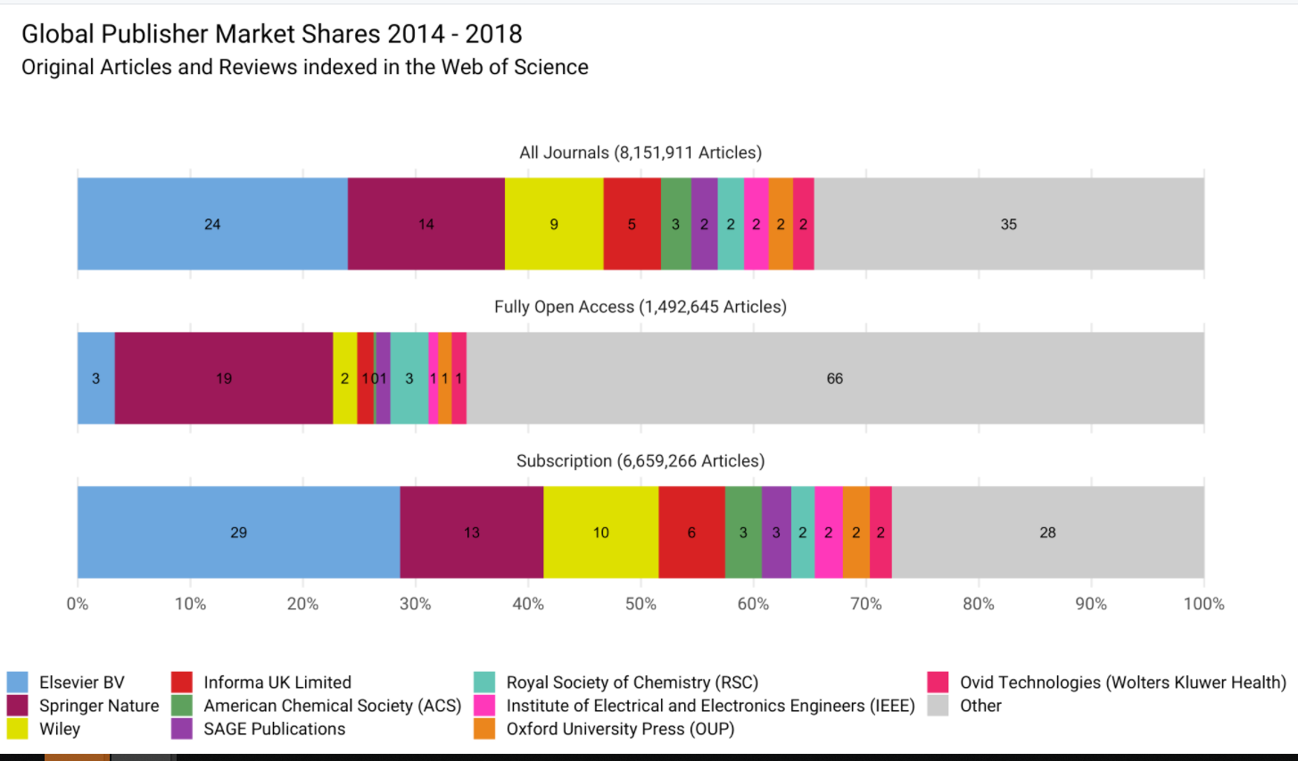
Article share by publisher, 2014-2018
Advancing OA for the majority of articles
Top 5 publishers: 55% of articles
https://github.com/subugoe/oa2020cadata/blob/master/analysis/paper.md
From: https://github.com/subugoe/oa2020cadata/blob/master/analysis/paper.md
Notes:
The point about advancing OA for the majority of UC articles is a core part of our thinking at UC, because if we don’t shift the existing large publishers to OA, we can’t transition the market in the near or intermediate term. This is a market where the Top 5 publishers publish 55% of articles, and the top 6 have 44% of the STM Publishing Market. While we might prefer less consolidation and a less of a profit-driven motive in the market for scholarly journals, nevertheless this is the market we are operating in now, and for the foreseeable future.
Our aim is therefore to take immediate steps in the existing landscape towards a world where OA publishing is the norm.
With that in mind, investing in OA publishing for the bulk of traditional journals seems like a particularly fertile area where libraries can accelerate a shift towards open access. This is action we can take, near term, to advance OA globally, which has the potential to shift the entire market so that open access is the baseline. This is a starting point of working towards a market pivoted to no paywalls.

Slide 10
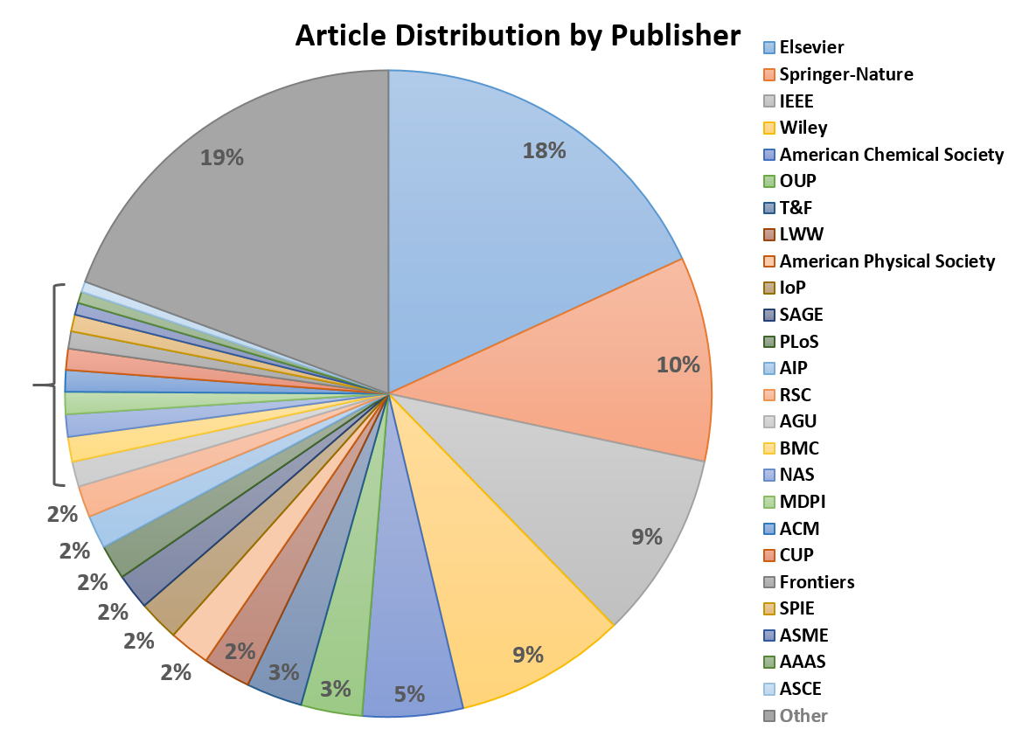
Shifting the majority of articles to OA: UC’s publishing reflects broader landscape
81% of UC articles are published by just 23 publishers
50% of UC articles -- 5 publishers:
Elsevier
SpringerNature
Wiley
IEEE
ACS
1%
Notes:
Our effort to negotiate with the largest publishers comes from analysis of UC’s publication patterns, which as you might expect mirror what we just saw of the worldwide landscape. 50% of UC authored articles are published by just 5 publishers, and as you see, Elsevier is at the top of the list. If we want to make UC’s articles – which are 10% of the nation’s research – available around the world to everyone, working with those top five publishers is an important part of the strategy.

Slide 11
Supporting researchers: transitioning existing valued journals
Importance of Factors When Selecting Where to Publish*
Quality and reputation of journal
Fit with Scope of journal
Audience
Impact Factor
Likelihood of acceptance
Time from submission to publication
Editor or editorial board
Open Access
“Reputation building within a specific field is at the heart of what matters most to academic scholars.”
*UC Pay It Forward Study, 2016
Notes:
And as We learned through the UC “Pay It Forward” study back in 2016, what authors really care about is finding their audience in the highest quality journal possible. Although the research found, and we continue to find – that most faculty and academic authors believe that open access is desirable, it’s not the most important element for most of them.
Authors want to publish in the journals that are top quality, provide them with the right audience, and which will support career and reputation development. With our transformative agreements, we can support our authors’ existing journal choices.

Slide 12
UC agreements:
Supporting all types of publishers
Including society, non-profit, and native OA publishers:
Cambridge University Press
Association for Computing Machinery (ACM)
JMIR Publications
Public Library of Science (PLOS)
Springer Nature
Canadian Science Publishing*
Company of Biologists*
The Royal Society*
_Elsevier _ *
<#10 not yet public>
* New in 2021
Prioritization process explained at https://osc.universityofcalifornia.edu/uc-publisher-relationships/priorities-for-publisher-negotiations/
Notes:
So at UC we have thought long and hard about the scale of change needed, and the current incentives for authors to stay with favored journals. For these reasons, we *do* want agreements with the large commercial publishers, however we do not want to focus our efforts ONLY on large commercial publishers. So at the same time that we are prioritizing the publishers with the largest volume of UC articles, we are also working with publishers of all sizes and types to advance open access across the existing market. (I’ve included a link on this slide that leads to more information about how we set priorities for these publisher engagements.)
To meet the strategic aim of making UC’s research openly available around the world, finding paths with publishers like Elsevier is crucial. And continuing to invest in paywalled journal access perpetuates a closed and inequitable system that limits the reach and impact of research.
With this approach – all sizes and types of publishers, and including explicity those with the largest UC publishing – we now have 30% of UC articles covered by an open access agreement, including with open access publishers, society publishers, and not-for-profit publishers.

Slide 13
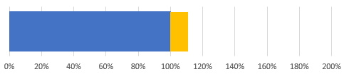
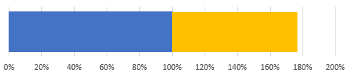
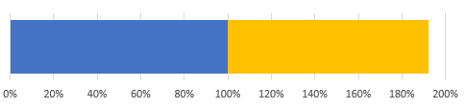
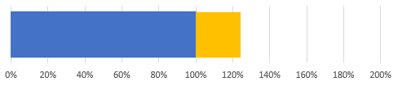
Addressing APC spend “in the wild”
(one year snapshot)
Sub$
Elsevier:
  Large, multidisciplinary
  Traditionally subscription
  Relatively few OA journals
+11%
APC$*
SpringerNature (+ BMC):
  Large, multidisciplinary
  Traditionally subscription
  Many OA journals, including megajournals
+77%
+92%
AAAS:
  Small, mission-driven
  One large OA journal (Science Advances)
~$40M
~$10M
Across UC
*APC spend estimated from WoS and Unpaywall
Notes:
The final point about the contributions of transformative agreements to the overall shift to OA is that they provide cost control for the entire university system. When libraries invest in subscriptions, even if they trim those investments as much as possible, they leave out of the cost control the author-based expenditures on article processing fees. This has been an area of significant growth, as you can see here from this snapshot of a recent year of UC’s data. The blue portion of the bar is based on actual subscription costs, and the gold was estimated based on WOS/Unpaywall data. What we see is that across UC the growth in author-based open access publication fees has been considerable , and from our analysis has added at least 25% beyond the amount the libraries were spending on subscriptions, some of it duplicatively in the same journals.
Background on the data:
This is a 1-year estimated snapshot illustrating how much we're spending annually on subscriptions vs. OA charges in a particular reference year,based on a recent year (2018 or 2019). The blue bar was based on actual sub costs, the gold was estimated based on WOS/Unpaywall data and list price APCs (though authors don't always pay list price APCs, so that could be over-estimated - but is still illustrative of the issues).

Slide 14
TAs as one near-term strategy to accelerate OA
Place the financial agency of libraries in the service of OA
  Redirect subscription expenditures, change the business model in partnership with publishers
  Support authors in publishing OA in their journals of choice-- lack of funds need no longer be a barrier
Allow more holistic financial management and cost control
  Bring subscription and OA expenditures together in a single agreement
  Control costs
Enable funding to follow authors
          Evolve financial support as author behavior and preferences evolve
Notes:
So at UC we see our transformative agreements as one near-term strategy to accelerate OA, a big tool that
Places the financial agency of libraries in the service of OA.
By Redirecting subscription expenditures, we change the business model in partnership with publishers
By Supporting authors in publishing OA in their journals of choice, we create a context where we follow author choices, and where lack of funds need no longer be a barrier
These agreements also allow for more holistic financial management by
Bringing subscription and OA expenditures together in a single agreement
Controlling costs
And these agreements enable funding to follow authors
We can evolve financial support as author behavior and preferences evolve

Slide 15
UC transformative agreements: leveraging licenses to advance schol comm aims
Automatic deposit
Author rights
CC licenses
No added author fees
Publishing Services Commitments:
  OASPA principles
  COPE best practices
  Waivers for APCs for unaffiliated authors and for Low and Lower-middle-income economies
  Digital preservation, perpetual access
  Sharing metadata with CrossRef
Looking towards: principles re: equity in publishing
Notes:
These agreements can also advance core aspects of the broader open access agenda. Our aim at UC is to leverage our negotiations to advance improvements in scholarly communication .
So our negotiations incorporate an effort to get automatic deposit to our repository eScholarship, including deposit services for articles where authors do not elect open access, and where they are not necessarily the corresponding author, with an aim to make all UC articles open access.
We also press for author rights and copyright retention, publishing under CC licenses, and publisher commitments services and standards, for example in relation to quality standards, infrastructure support, and providing mechanisms for equitable access to publishing via APC waiver programs.
We have just taken initial steps to contribute to some collaborative work that is just being formulated with the idea of drafting principles that will further support equity in publishing, which we hope to include in our negotiation of transformative agreements moving forward.
Background on Publishing services commitments language:
Publisher commits to complying with industry standards for ethical and quality publishing, including The Principles of Transparency and Best Practice in Scholarly Publishing (https://oaspa.org/information-resources/principles-of-transparency-and-best-practice-in-scholarly-publishing/) and COPE (Committee on Publication Ethics) Core practices (https://publicationethics.org/core-practices). Publishers that charge APCs commit to providing APC waivers for unaffiliated authors and authors from Low- and Lower-Middle-Income Economies as defined by the World Bank at https://datahelpdesk.worldbank.org/knowledgebase/articles/906519-world-bank-country-and-lending-groups.

Slide 16
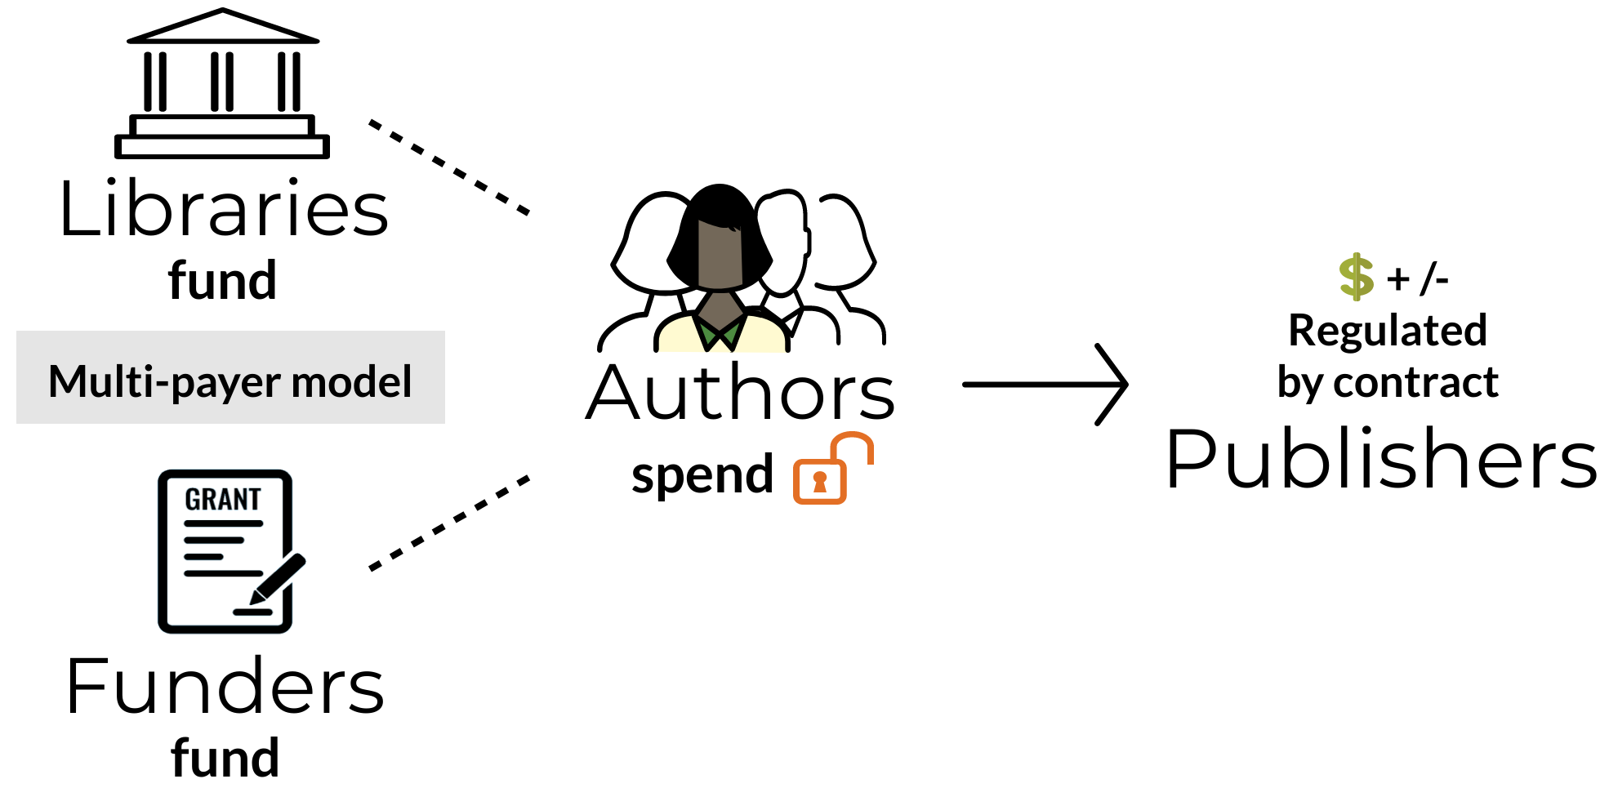
UC’s multi-payer model: experimenting with sustainable approach to OA for research-intensive institutions
Open access shouldn’t cost more; the transition can happen with existing funds within the publishing ecosystem.
Multi-payer model
For research-intensive institutions, this can be accomplished through a system that combines institutional (i.e. subscription) and grant funds in a regulated approach. We call this a 'multi-payer’ model.
Notes:
Related to advancing scholarly communication aims, another element of our transformative agreements is an experimental workflow to enable the introduction of grant funds into the payment stream for publishing, along with library funding. Authors who choose open access have their OA fee reduced based on library payments, and have the option to contribute grant funds, if available, or have the libraries support the full open access fee.
We call this the multipayer model. It emerged from UC’s pay it forward study, which determined that the ability to draw in grant funds would be very important for research-intensive institutions to enable a full transition to OA. The workflow is designed to reflect the reality that in the US, grant funds are controlled at the author level, unlike in Europe for example.
We have successfully implemented this model for the Elsevier agreement, and for 7 other agreements as well.

Slide 17
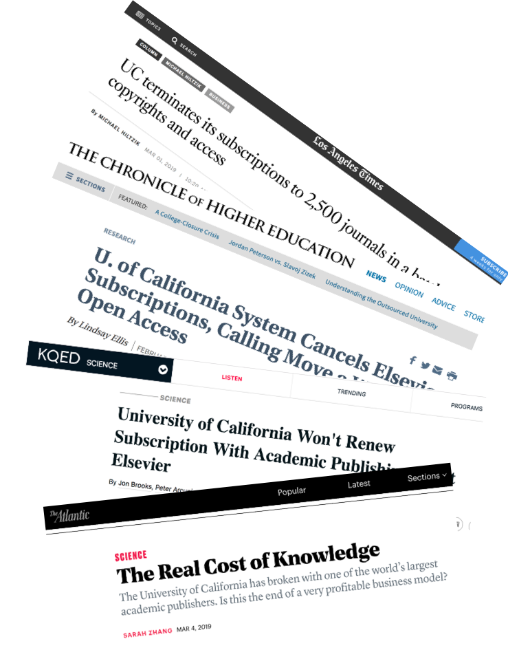
Elsevier: the starting point
Notes:
So that is the context for how UC has been approaching OA transformation, and how transformative agreements fit into the broad picture of strategy, policy and practice.
The very first publisher that UC’s negotiations team worked with on a transformative agreement was Elsevier. At first, as you know, the negotiations did not result in a contract. UC walked away.

Slide 18
However: New Elsevier agreement meets all UC goals
100% OA publishing for UC authors (incl. Cell / Lancet)
Cost reduction and stringent cost controls for the University as a whole
Responsive to Faculty Senate principles to transform scholarly communication
  Unanimously endorsed by Senate library committee
Notes:
However, the agreement we reached about 2 years later meets all of our original goals.
100% OA publishing for UC authors (incl. Cell / Lancet)
Cost reduction and stringent cost controls for the University as a whole:
Protections for publishing growth and cases where authors contribute less than expected from grant funds.
3. Responsive to Faculty Senate principles to transform scholarly communication
The agreement was unanimously endorsed by Senate library committee

Slide 19
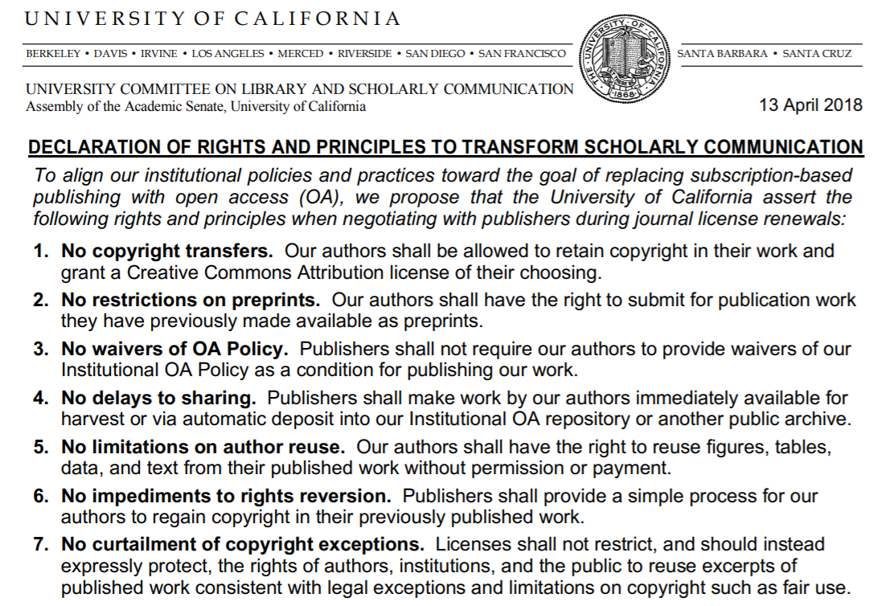
Responsive to Faculty Senate principles
Authors retain copyright
Articles have a CC BY license by default
Support for open data sharing
  Elsevier is building Dryad integration into Editorial Manager
Elimination of institutional OA policy waiver requirement
  Elsevier agreed to remove the institutional OA policy waiver requirement from its standard publishing agreement, for all authors worldwide
During our negotiation, Elsevier joined DORA and announced that it was opening up its citation data
Notes:
To say a bit more about how the Elsevier agreement is responsive to our UC faculty senate principles– you may recall I mentioned at the outset that a key part of the joint UC strategic plan for transforming scholarly communication was the faculty senate committee’s “Rights and Principles” . Of these, the Elsevier agreement satisfies almost all of the faculty principles, including importantly:
Authors retain copyright
This is a fundamental way that this kind of transformative agreement advances us in creating a greater degree of freedom from publishers – our authors retain copyright, and their work product is no longer the property of the publisher.
Articles have a CC BY license by default
There is support for open data sharing
Elsevier agreed to build Dryad integration into Editorial Manager – and this we have learned will be in production soon
And very importantly, the agreement includes the elimination of the institutional OA policy waiver requirement.
Elsevier agreed to remove the institutional OA policy waiver requirement from its standard publishing agreement, for all authors worldwide, and has done so. This changes the author rights equation for UC authors, including those who are not making their articles OA under the agreement (such as coauthors who are not the corresponding author) . This changes the author rights equation for authors on other campuses with permission-based OA policies as well.
In addition, during our negotiation, Elsevier joined DORA and announced that it was opening up its citation data
Background on author publication language:
Resulting author agreement language still asks author to represent that there are no prior rights or licenses, so the language is not ideal, but it is a big step forward not to have the author required to represent they have waived any institutional OA policy.
The prior (and now removed) language appears bold below; the new version of the language includes only the text in black.
“Except as expressly set out in this Journal Publishing Agreement, the Article is not subject to any prior rights or licenses and, if my or any of my co-authors’ institution has a policy that might restrict my ability to grant the rights required by this Journal Publishing Agreement (taking into account the Author Rights permitted hereunder, including Internal Institutional Use), a written waiver of that policy has been obtained.”

Slide 20
Additional key attributes
Funding follows authors in publishing-based agreement
  This is a pure publishing agreement: we only pay Elsevier if UC authors publish with them. If our authors go elsewhere, so does our funding.
  (Minimum spend only if publishing drops more than 20% below 2019 levels)
Authors control their publishing output
  Authors retain copyright; OA default with CC BY license
  Can also choose more restrictive license, or opt out of OA publishing
  Authors who opt out can deposit their AAMs under UC’s OA policy
Provides equitable access to OA publishing for unfunded / early career authors
  In all of our agreements, our multi-payer approach has been welcomed—and actively used—by UC authors who lack grant funding—including grad students, post-docs, and other early career or under-resourced scholars
Drives down ELS revenue per article
  Elsevier’s revenue per article will be dramatically lower under this agreement than most of its other transformative agreements
    $2900 or less (even including CP/TL)
Notes:
Additional key attributes of the Elsevier agreement include that our funding follows authors in this purely publishing based agreement.
we only pay Elsevier if UC authors publish with them. If our authors go elsewhere, so does our funding.
There is a Minimum spend but we hit it only if publishing drops more than 20% below 2019 levels
Authors control their publishing output
Authors retain copyright. As noted, there is an OA default: articles published under CC BY license.
Can also choose a more restrictive license [CC BY NC ND], or opt out of OA publishing
Authors who opt out can deposit their AAMs under UC’s OA policy
Equitable access to OA publishing for UC authors who are unfunded or early career
In all of our agreements, our multi-payer approach has been welcomed—and actively used—by UC authors who lack grant funding—including grad students, post-docs, and other early career or under-resourced scholars
Drives down Elsevier’s revenue per article
Elsevier’s revenue per article will be dramatically lower under this agreement than most of its other transformative agreements
Their revenue per article is $2900 or less under our agreement – a derived or calculated value, not a negotiated value. (even including CP/TL) [compared to $4500 - $6500 calculated for other agreements]
(This is a derived or calculated value, not a negotiated value)

Slide 21
Benefits of UC transformative agreements
Open access for all research articles with a UC corresponding author
Read access to all other scholarly content from the publisher
APC cost-share model across multiple funding sources (grants and library)
Cost controls to allow for growth in UC research publications without uncontrolled cost increases
Addressing system-wide costs (APCs contributed by authors)
Advancing faculty principles for scholarly communication
Big impact - currently 30% of all UC corresponding author articles covered
Notes:
To summarize --
UC’s transformative agreements with Elsevier and other publishers achieve some important and hard-won goals for UC, including: open access for all research articles with a UC corresponding author, read access to all other scholarly content from the publisher, a cost-sharing model across both library and grant funding sources, and cost controls to allow for growth in UC research publications without uncontrolled cost increases. The agreements address system-wide costs, incorporating APCs contributed by authors. These agreements also advance our faculty principles for scholarly communication and are having a big impact on the proportion of UC articles that can be published OA.

Slide 22
Some transformative agreement challenges
Conceptual complexities
Administrative burdens
Equity questions – unintended consequences?
Notes:
That said, transformative agreements are not, themselves, the single solution for transforming the scholarly communication landscape into an open and equitable environment. While they play a substantial role in opening up research to a global audience, they also carry with them certain conceptual complexities, logistical issues, and equity questions have surfaced within the community in the wake of UC’s transformative agreement announcement with Elsevier.
Core issues we see are that it is sometimes difficult for the community to fully understand the nuances of these complex agreements; implementing any one of these agreements is complicated, let alone managing a growing number; and the community is divided over APCs, with some OA advocates arguing that they work for well-resourced scholars, disciplines, and institutions, but they create equity issues for those who lack access to such funding. This is difficult terrain. UC’s approach to that terrain as been to continue to design, resource, test and evaluate many models, to determine which ones play a significant role in getting us to the open future we desire for the global scholarly community.
While we carry out these experiments, a foundational observation is that transformative agreements do address a major problem of equitable access to science and scholarship - creating timely access to published research across the entire world, for anyone with an internet connection/cell service. That’s a good thing.
And we believe there are ways to explore transformative agreements that include author-facing publication charges, in ways that help avoid or reduce inequities.

Slide 23
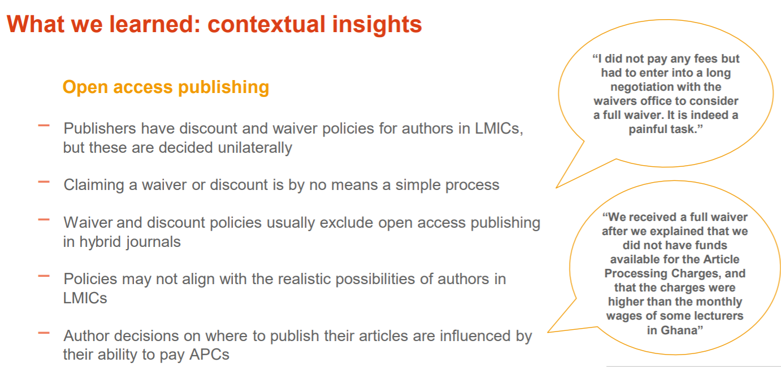
OA2020 LMIC Working Group Study-in partnership with EIFL and library consortium coordinators in EIFL countries
Slide credit: Colleen Campbell, MPDL
Notes:
For example, One current effort we are involved in is that we have three UC library staff members involved in an OA2020 working group studying the market in LMICs for open access publishing. This OA2020 LMIC working group, in partnership with the not for profit group EIFL (Electronic Information for Libraries), set out to analyze the publishing output and the financial streams around scholarly publishing in a sampling of countries, in order to better understand the potential for transformative agreements in LMICs. The group looked at Ghana, Kenya, and Ukraine , which are Lower Middle Income countries, and Georgia, which is classified as a Middle Income country.
I’ve taken this slide from Colleen Campbell’s recent talk about the group’s findings, which she shared at the Digital initiatives symposium in April. I wanted to draw out the particular theme of APC waivers, since it is a core topic when considering how open access business models operate worldwide.
As you’ll see from the findings described here, there are limitations generated by the way APCs waivers are currently being applied. It can be burdensome for authors to obtain waivers, and APC charges can be unrealistic for authors in Lower and middle income countries. Publishers unilaterally control how the waivers are applied, and authors decisions about where to publish are being influenced by the ability to pay APCs.
Background: Details of the talk:
Apr 29th, 11:15 AM - 11:55 AM Where is the Social Democr e is the Social Democracy in Subscription P acy in Subscription Paywalls? E ywalls? Effects and Impact of Transitioning Journals from Subscriptions to Open Access on Resear Access on Researchers in De chers in Developing and T eloping and Transition E ansition Economies conomies Colleen Campbell Max Planck Digital Library, campbell@mpdl.mpg.de
Details of EIFL– i
This study was done in partnership with EIFL (Electronic Information for Libraries), which is a not-for-profit organization that works with libraries and library consortia in developing and transition economy countries in Africa, Asia Pacific, Europe and Latin America to enable access to knowledge for education, learning, research and sustainable community development.
More detail on the study-
The data we gathered focused on the two transactional streams around scholarly journal publishing, subscription fees (to provide researchers as readers with access to journal content) and article processing charges (to provide researchers as authors with open access publishing services), for the countries and publishers considered. The group has been particularly focused on the
current investment around scholarly journals in these countries
What discounts and waivers are scholarly publishers currently applying in these countries for subscriptions and open access publishing and under what conditions?
Would current spend on subscriptions and APCs cover all publishing costs in a purely open access world based on current market conditions?
How might consortia from Lower Middle Income Countries engage in the global effort to transition the current corpus of scholarly journals to open access?

Slide 24
OA2020 LMIC Working Group Study-in partnership with EIFL and library consortium coordinators in EIFL countries
Observation 3
Waivers and discounts provide some level of economic relief, but optimization and standardization is needed on the immediate term.
With data in hand, longer term approaches can be explored by the community to ensure equitable opportunities for authors in LMICs to publish their articles openly in the scholarly journals of their choice.
Possible actions
Central agreements to govern application of waivers and discounts.
Multi-stakeholder re-evaluation of waiver/discount criteria
Multi-stakeholder exploration of additional mechanisms for equitable conditions for open access publishing services
Slide credit: Colleen Campbell, MPDL
24
Notes:
The working group has considered these findings, which suggest that waivers and discounts provide some level of economic relief, but also call out for optimization and standardization in the immediate term, while the community explores additional mechanisms for ensuring equitable opportunities for authors in LMIC countries to publish their articles openly in the scholarly journals of their choice.
The group has converged on some possible actions:
Including Central agreements to govern application of waivers and discounts.] The group sees potential in the development of aligned strategies for engaging publishers in centralized (institutional or consortium-level) bilateral agreements that optimize and standardize waiver and discount schemes.
Such agreements could include mechanisms to ensure:
Automatic identification of eligible authors as part of the publisher’s submission and publication process, alleviating authors from the burden of having to actively request waivers.
Offering discounts and waivers for open access publication in hybrid journals in the same measure that they are for fully open access journals, to give authors equal opportunities to openly publish their articles in the journals of their choice.
The working group also sees potential in Multi-stakeholder re-evaluation of waiver/discount criteria. Such a group could be tasked with developing a more equitable and realistic discount and waiver framework. One idea the group has been considering is for some form of certification system to be established to identify those publishers/journals that adhere to the framework, and implementation could become a precondition for institutional or consortium/national agreements with scholarly publishers, potentially prompting further take-up of the framework by additional publishers.
Finally, the group has considered Multi-stakeholder exploration of additional mechanisms for equitable conditions for open access publishing services
The working group’s thinking is that a group of local and international stakeholders could convene to explore additional principles and mechanisms to ensure equitable conditions that enable researchers in LMICs to publish their articles openly.

Slide 25
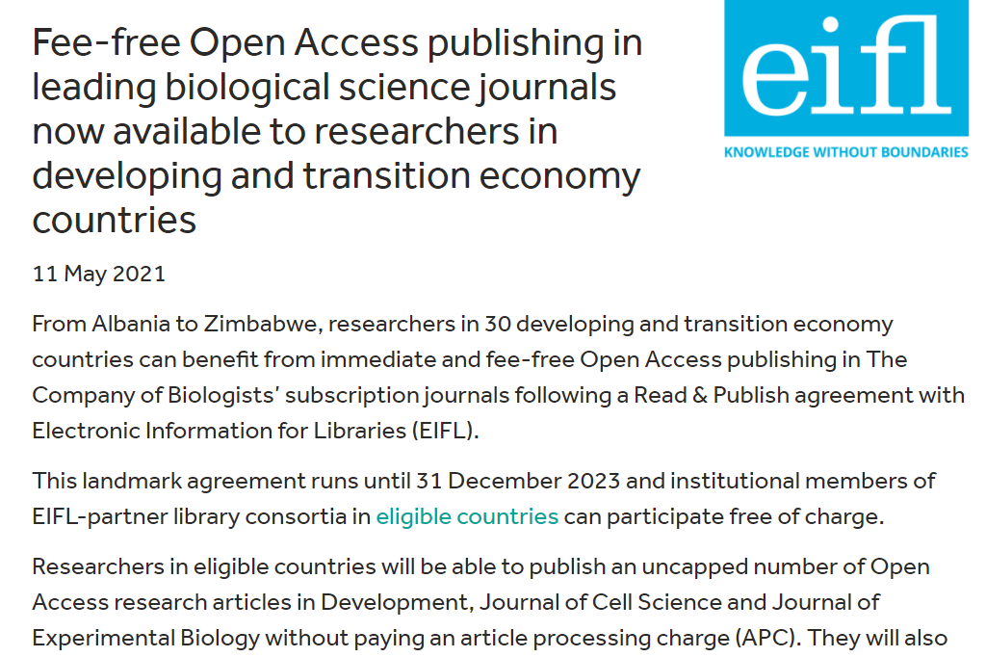
Library consortia role re: equitable access
Notes:
In closing, I’d like to share one example of near-term actions that advance open access globally while addressing regional economic differences and which contains aspects of the working group’s recommendations.
An agreement has recently been announced between the Company of Biologists, a not-for-profit publisher committed to a transition to open access, and EIFL. The agreement will provide for authors in 30 countries in Africa, Asia Pacific, and Europe to publish open access in the COB’s 3 hybrid journals without any application for a waiver, and provide reading access in those countries as well. The agreement formalizes practices already in place by providing waivers.
This kind of approach, especially if supported by the kind of multi-stakeholder standards the OA2020 working group has suggested, could provide an important near-term adjustment to open access business models as we transition the entire ecosystem.
In the near term there are other important signals in the environment, too. For example, we see the remarkable takeup of read and publish agreements in the US with Cambridge University Press. Since UC and CUP launched the first such agreement in the US in 2020, the total number of institutions in the US with such agreements has surpassed 140, including the Big Ten Academic Alliance and the University of Texas system. Cambridge reports that at this point approximately 25 percent of the research that is authored by researchers at U.S. institutions and published by Cambridge University Press and associated society-owned journals will now be published openly with no additional cost to the researcher or the institution. This seems like a big shift in our environment. Meanwhile, PLOS has been launching journals under a new business model that is specifically aimed at equity and which does not involve APCs.
These developments are clearly part of an evolving landscape, and at UC we continue to look towards actions we can take within our sphere to advance open access to UC’s research, and equitable open access worldwide. We are working towards a world where OA publishing is the norm. We are doing that through a kind of pragmatic -or practical- idealism as one of our University librarians and members of our transformative agreements group called it. We are taking action to influence the market through partnerships across the landscape, through following our authors’ publishing choices, and through investing in open infrastructure – all to enable the widest possible sharing of research and scholarship, while controlling the costs, and iteratively addressing unintended consequences.

Slide 26
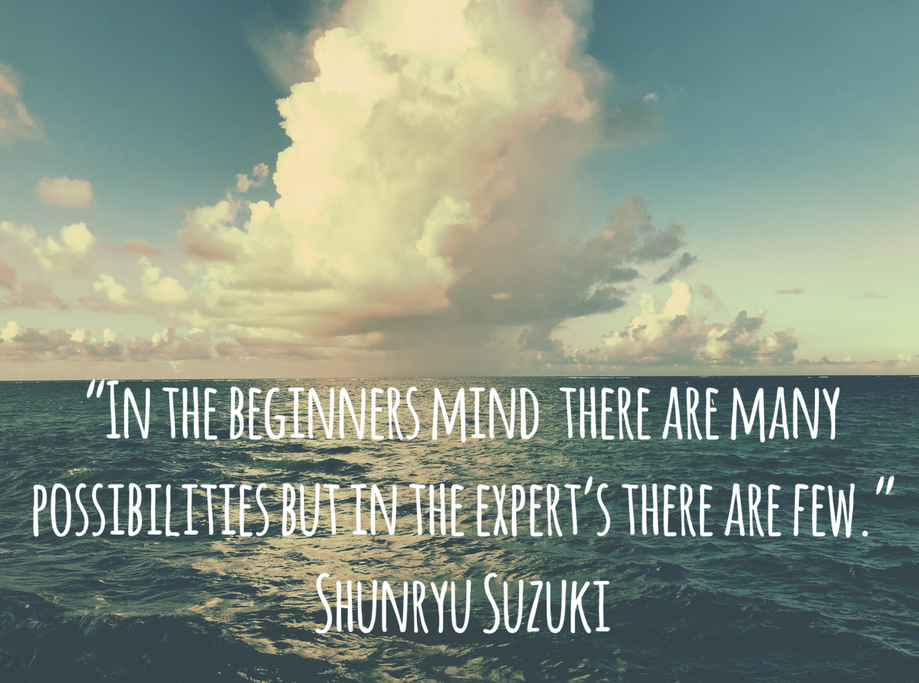
The way forward: Iterative, principles-based actions to advance open access
https://harlemyogastudio.com/embracing-a-beginners-mind/
Image: https://reverseritual.com/the-art-science-of-magic/
Notes:
As many of you know, I’m fairly new to UC. Joining the team after so much had already been accomplished, I have been impressed by what I see at UC – an approach that to me manifests the power of a concept from the Buddhist tradition, of ‘beginner’s mind” . The concept refers to having an attitude of openness, eagerness, and lack of preconceptions when studying a subject, even when studying at an advanced level, just as a beginner would. It calls upon us to question our expertise, our habituated assumptions, and to come to the problems at hand with the “curiosity, open-ness, and wonder” of the beginner. This seems like the mental frame we all need to navigate a wildly changed and changing landscape, and it feels woven into the wide range of approaches we are taking at UC, and our adjustments as we move forward.
As one reflection of that, our approach at UC with transformative agreements is not directed at supporting the APC model for open access as an end-state single solution to open access worldwide. We see this model as a transitional state, providing a means of shifting away from investing our dollars in paywalled access, and have been working on modifying it through research, experimentation and assessment (including the multipayer workflow) and through negotiations to control system-wide costs and draw in research funders to the equation. We are simultaneously building and contributing to infrastructure for other models. We are working towards a world where OA publishing is the norm, a long term strategy that requires experimentation, exploration, and can benefit by the “beginner’s mind.”
So We operate in the landscape with an emphasis on a range of actions we can take now to influence productive change. Meanwhile, we watch and tailor our actions in response to the broader signs of support for the worldwide shift. These include for example active engagement from research funders such as PlanS, having influential international bodies like UNESCO weighing in with Open Science recommendations, and seeing some traction growing around reconsideration of research metrics through initiatives – going beyond DORA to include initiatives like the active National Academies Roundtable on Aligning Incentives for Open Science, which is co-chaired by UCSF’s KEITH R. YAMAMOTO, vice chancellor for science policy and strategy.
The unfolding of these high level and international efforts give us great optimism about what is to come. At UC, we look forward to working with you all, to leverage every tool we have together, every step of the way.
Thank you!
https://uxdesign.cc/beginners-mind-in-ux-design-with-shunryu-suzuki-11a00787c8a9
https://harlemyogastudio.com/embracing-a-beginners-mind/
Background on beginner’s mind:
“Beginner’s mind”. Having a beginner’s mind means to practice each day…with the enthusiasm of the beginning, with the desire to discover new things, taking in everything you experience.
The purpose of the practice is to always keep pure the mind like that of an amateur.
This beginner’s mind is very hard to keep.
DORA: The Declaration on Research Assessment (DORA)

