Slide 1

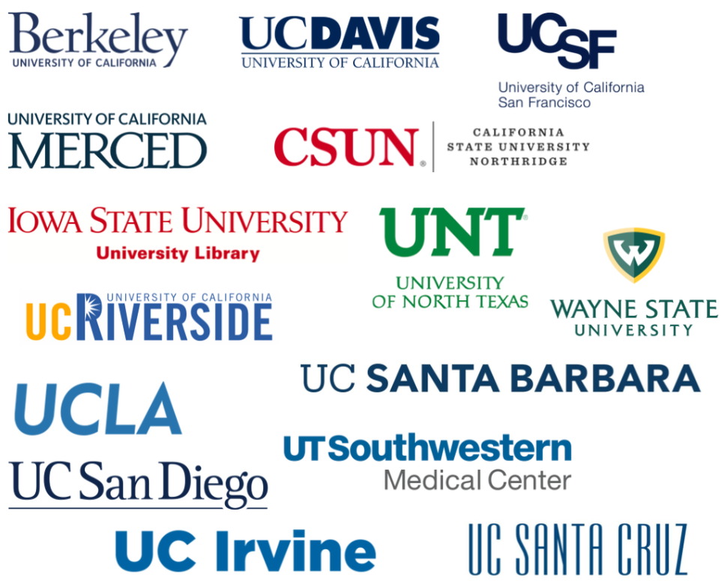

Community of Practice
Negotiating and Implementing OA and Transformative Agreements
Coordinated by the US OA2020 Working Group
Facilitating today:
Anneliese Taylor
University of California, San Francisco
Colleen Campbell
Open Access 2020 Initiative
https://oa2020.us/

Slide 2
Our topic today
Securing Stakeholder Buy-in: Making the Case for Open Access Agreements
Today’s guest speakers:
Dr. Kum-Kum Bhavnani
Distinguished Professor of Sociology at UC Santa Barbara
Chair of the University of California Academic Senate, 2019-20
Curtis Brundy
AUL for Scholarly Communications and Collections
Iowa State University

Slide 3
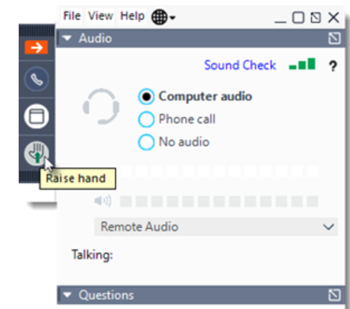
Housekeeping
Feel free to pose questions in the question pane at any time; we will get to them in the discussion portion of the session.
During Q&A you can also raise your hand to speak, and an organizer will unmute you.
The session is being recorded and we will share a link.

Slide 4
Recent updates
CoP workshop on how to gather and analyze publication data to understand the publishing profile of your institution for strategic considerations, date TBD
See survey: https://forms.gle/GmNZ21Mrp92GCNbGA (open until October 2nd)
Charleston Conference pre-Conference: How to successfully negotiate and implement transformative and central open access publishing agreements
Thursday, October 22, 9:00 am – 12:00 pm Eastern (Cost: $50)
Topic for our November call: Cost models and transition mechanisms: how former subscription expenditures shift to open access publishing
University of Alberta becomes first Canadian institution to sign the OA2020 Expression of Interest
Washington State University joins Association for Computing Machinery open access publishing model
To receive complete monthly OA2020 updates write “keep me informed” to contact@oa2020.org

Slide 5
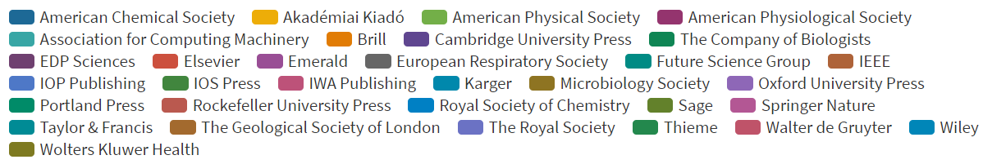
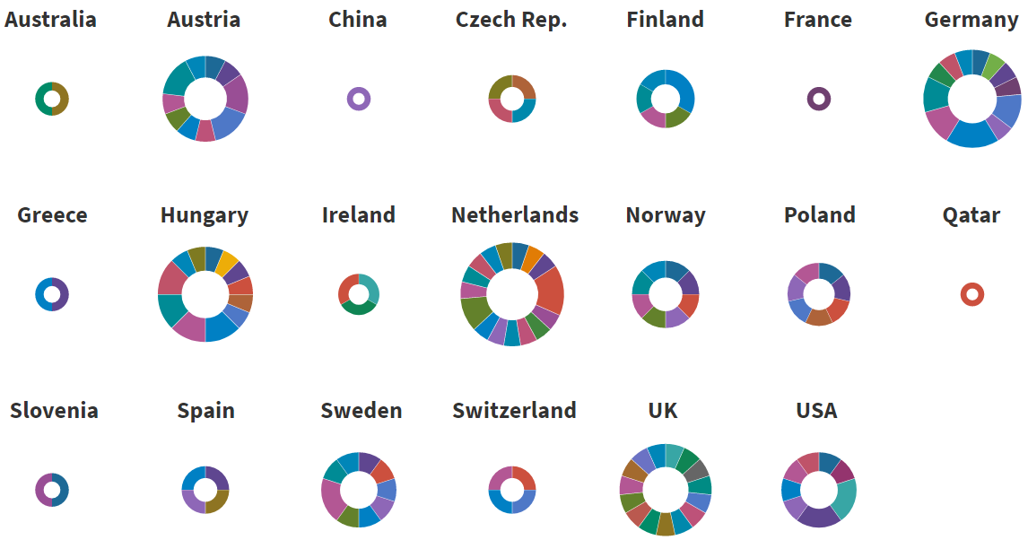
Recent updates
https://esac-initiative.org/about/transformative-agreements/agreement-registry/

Slide 6
Our topic today
Securing Stakeholder Buy-in: Making the Case for Open Access Agreements
Curtis Brundy
AUL for Scholarly Communications and Collections
Iowa State University
Dr. Kum-Kum Bhavnani
Distinguished Professor of Sociology at UC Santa Barbara 2019-20 Chair of the University of California Academic Senate

Slide 7
Our topic today
Securing Stakeholder Buy-in: Making the Case for Open Access Agreements
Curtis Brundy
AUL for Scholarly Communications and Collections
Iowa State University
Dr. Kum-Kum Bhavnani
Distinguished Professor of Sociology at UC Santa Barbara
Chair of the University of California Academic Senate, 2019-20

Slide 8
Topic of our November call
Cost models and transition mechanisms: how former subscription expenditures shift to open access publishing

Slide 9
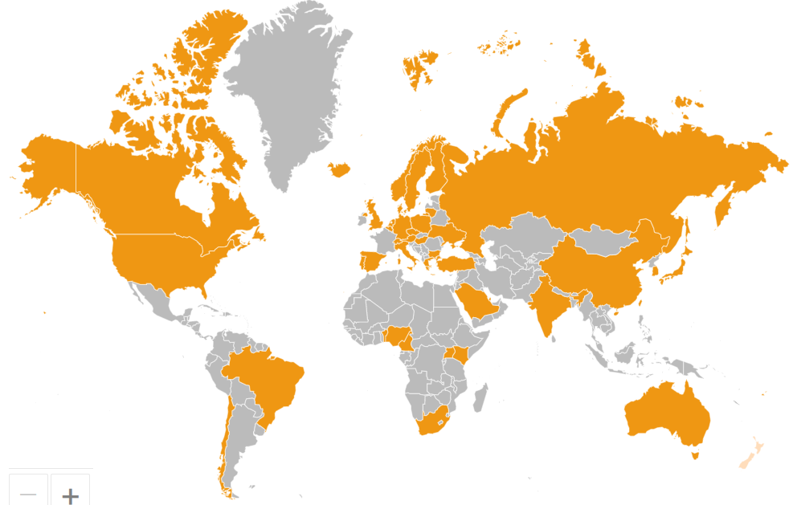
Join the US Signatories of the
OA2020 Expression of Interest in the Large Scale Transformation of Scholarly Journals to Open Access
We aim to transform a majority of today’s scholarly
journals from subscription to OA publishing in
accordance with community-specific publication preferences.
At the same time, we continue to support new and improved forms of OA publishing.
We will pursue this transformation process by converting resources currently spent on journal subscriptions into funds to support sustainable OA business models.
Accordingly, we intend to re-organize the underlying cash flows, to establish transparency with regard to costs and potential savings, and
to adopt mechanisms to avoid undue publication barriers.
https://oa2020.org/mission

Slide 10
Community of Practice
Negotiating and Implementing OA and Transformative Agreements
Thank you for participating!
Contact and Resource Information
Please e-mail us at: oa2020us@googlegroups.com
OA2020 United States
https://oa2020.us/
Sign up for the OA2020 global newsletter
contact@oa2020.org
Learn more about Transformative Agreements through the ESAC Initiative https://esac-initiative.org/

Slide 11
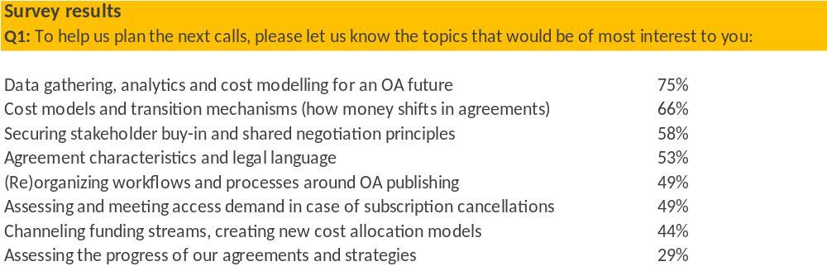
Topics for discussion

